Slide 1


AWS STEP FUNCTIONS

Slide 2
INTRODUCTION
AWS Step Functions is a serverless function orchestrator that makes it easy to sequence AWS Lambda functions and multiple AWS services into business-critical applications.
With its built-in operational controls, Step Functions manages sequencing, error handling, retry logic, and state, removing a significant operational burden from your team.
Advantages
Build and update apps quickly : AWS Step Functions lets you build visual workflows that enable fast translation of business requirements into technical requirements. You can build applications in a matter of minutes, and when needs change, you can swap or reorganize components without customizing any code.
Improve resiliency : AWS Step Functions manages state, checkpoints and restarts for you to make sure that your application executes in order and as expected. Built-in try/catch, retry and rollback capabilities deal with errors and exceptions automatically.
Write less code : AWS Step Functions manages the logic of your application for you, and implements basic primitives such as branching, parallel execution, and timeouts. This removes extra code that may be repeated in your microservices and functions.

Slide 3
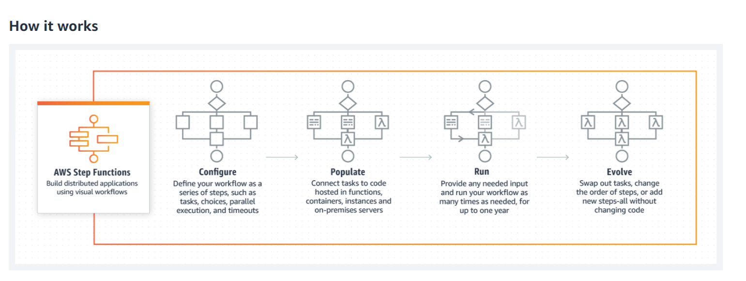
Tutorial : https://aws.amazon.com/getting-started/hands-on/create-a-serverless-workflow-step-functions-lambda/

Slide 4
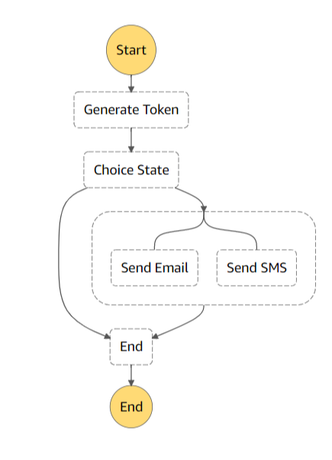
Example :
This State Machine specifies the workflow of the Step functions that need to be executed.
As you can see, It generates a 4 digit token and if token is generated successfully, it sends email and SMS parallely.
We run a serverless workflow that coordinates multiple AWS Lambda functions. For this we create an IAM role that allows Step Functions to access Lambda.
Here, we have 4 lambda functions :
To call/invoke this State Machine from our application
For Generating Token
Send Email
Send SMS

